Slide 1
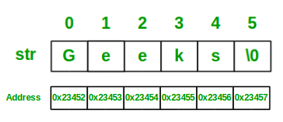
STRING HANDLING
Strings in Java
Strings are defined as an array of characters. The difference between a character array and a string is the string is terminated with a special character ‘\0’.
Below is the basic syntax for declaring a string in Java programming language.
Syntax:
<String_Type> <string_variable> = “<sequence_of_string>”;
Example:
String str = "Geeks";
Use of Strings
You know that login screen, where you type in your username and password? Strings.
Those product descriptions on shopping web sites? Strings.
Most web output on any page of a Java web application will be made up of lots of little Strings of data. It might even all be a giant String as it is assembled.
Whenever you pull any text data out of a database - you guessed it, Strings.
They are everywhere, used for everything. Just think up some text data, and say “that goes in a String”
String is a sequence of characters. In java, objects of String are immutable which means a constant and cannot be changed once created.

Slide 2
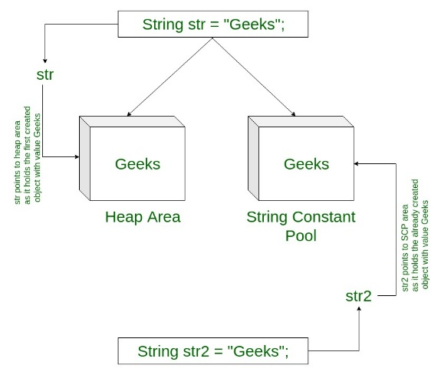
continued
Memory allotment of String
Whenever a String Object is created, two objects will be created- one in the Heap Area and one in the String constant pool and the String object reference always points to heap area object.
For example:
String str = "Geeks";
Interfaces and Classes in Strings in Java
CharBuffer: This class implements the CharSequence interface. This class is used to allow character buffers to be used in place of CharSequences. An example of such usage is the regular-expression package java.util.regex.
String: String is a sequence of characters. In java, objects of String are immutable which means a constant and cannot be changed once created.
Creating a String
There are two ways to create string in Java:
String literalString s = “GeeksforGeeks”;
Using new keywordString s = new String (“GeeksforGeeks”);
StringBuffer: StringBuffer is a peer class of String that provides much of the functionality of strings. String represents fixed-length, immutable character sequences while StringBuffer represents growable and writable character sequences.
Syntax:
StringBuffer s = new StringBuffer("GeeksforGeeks");
StringBuilder: The StringBuilder in Java represents a mutable sequence of characters. Since the String Class in Java creates and immutable sequence of characters, the StringBuilder class provides an alternate to String Class, as it creates a mutable sequence of characters.
Syntax:
StringBuilder str = new StringBuilder(); str.append("GFG");
StringTokenizer: StringTokenizer class in Java is used to break a string into tokens.

Slide 3
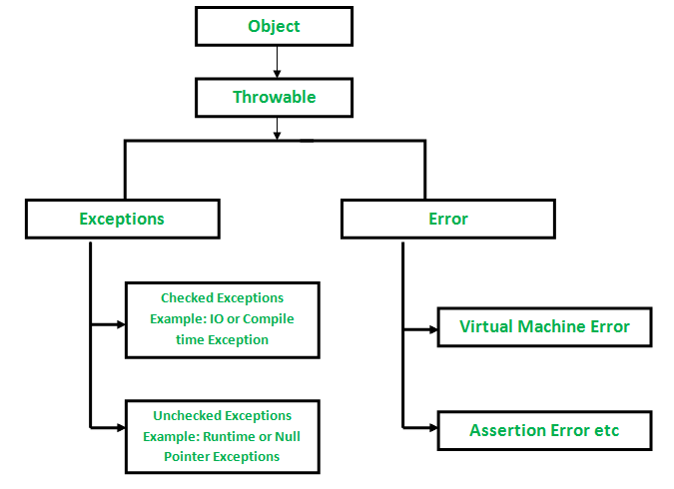
Exception Handling
Study | Detail | Error Rate
Baddeley & Longman [1973] | Entering mail codes. Errors after correction. Per mail code. | 0.5%
Chedru & Geschwind [1972] | Grammatical errors per word | 1.1%
Dremen and Berry [1995] | Percentage error in security analysts' earnings forecasts for reporting earnings | 30%
Grudin [1983] | Error rate per keystroke for six expert typists. Told not to correct errors, although some did. Per keystroke. | 1%
Hotopf [1980] | S sample (speech errors). Per word | 0.2%
Hotopf [1980] | W sample (written exam). Per word | 0.9%
Hotopf [1980] | 10 undergraduates write for 30 minutes, grammatical and spelling errors per word | 1.6%
What is an Exception?
An exception is an unwanted or unexpected event, which occurs during the execution of a program i.e at run time, that disrupts the normal flow of the program’s instructions.
Error vs Exception
Error: An Error indicates serious problem that a reasonable application should not try to catch. Exception: Exception indicates conditions that a reasonable application might try to catch.
Exception Hierarchy
All exception and errors types are sub classes of class Throwable, which is base class of hierarchy.One branch is headed by Exception. This class is used for exceptional conditions that user programs should catch. NullPointerException is an example of such an exception.Another branch,Error are used by the Java run-time system(JVM) to indicate errors having to do with the run-time environment itself(JRE). StackOverflowError is an example of such an error.

Slide 4
continue
How JVM handle an Exception?
Default Exception Handling : Whenever inside a method, if an exception has occurred, the method creates an Object known as Exception Object and hands it off to the run-time system(JVM). The exception object contains name and description of the exception, and current state of the program where exception has occurred. Creating the Exception Object and handling it to the run-time system is called throwing an Exception.There might be the list of the methods that had been called to get to the method where exception was occurred. This ordered list of the methods is called Call Stack.Now the following procedure will happen.
The run-time system searches the call stack to find the method that contains block of code that can handle the occurred exception. The block of the code is called Exception handler.
The run-time system starts searching from the method in which exception occurred, proceeds through call stack in the reverse order in which methods were called.
If it finds appropriate handler then it passes the occurred exception to it. Appropriate handler means the type of the exception object thrown matches the type of the exception object it can handle.
If run-time system searches all the methods on call stack and couldn’t have found the appropriate handler then run-time system handover the Exception Object to default exception handler , which is part of run-time system. This handler prints the exception information in the following format and terminates program abnormally.
Handling Exceptions Using try and catch
The try structure has three parts:
The try block : Code in which exceptions are thrown
One or more catch blocks : Respond to different Exceptions
An optional finally block : Contains code that will be executed regardless of exception occurring or not
The catch Block:
If exception occurs in try block, program flow jumps to the catch blocks.
Any catch block matching the caught exception is executed.

Slide 5
Catching Exception Using try and catch
The general form of exception handling block:
try {
//code to be monitored.
}
catch (Exception1 e1 ) {
//exception handler for Type Exception1
}
catch (Exception2 e2 ) {
//exception handler for Type Exception2
}
finally {
// code that must be executed.
}

